Slide 1

AASD 4000
Machine Learning - I
Applied AI Solutions Developer Program

Slide 2
Module 03 Machine Learning
Vejey Gandyer

Slide 3
Agenda
What is ML?
Traditional vs ML Approach
ML Intuition
Task: ML Problems Identification
Types of Machine Learning
Task: ML Problem Types
ML Concepts
Evaluation Metrics

Slide 4
ML
What is it?

Slide 5
What is ML?
Machines Learn
How to combine input
To produce predictions
On unseen data

Slide 6
ML vs Traditional Programming
Data
Traditional Programming
Computer
Output
Learn output from data given rules
Program
(Rules)
Data
Machine Learning
Computer
Program
(Rules)
Learn rules from data given desired output
Output

Slide 7
ML Intuition
Digit Recognition

Slide 8
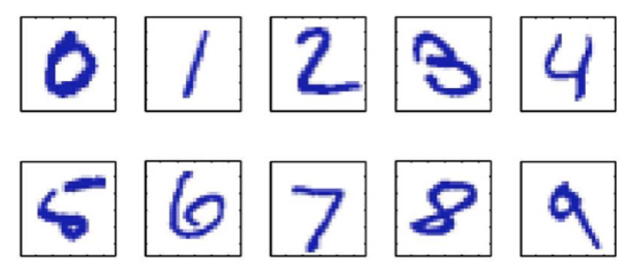
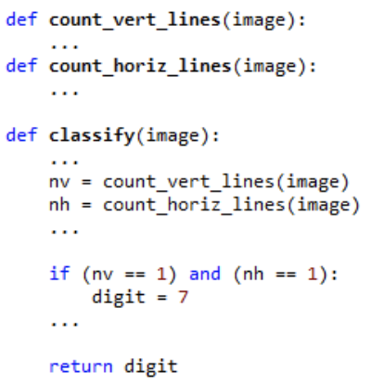
ML Intuition
Task: Digit Recognition
Build an expert algorithm that identifies these digits from your own expertise of digits identification
Assumptions: All given images are 16*16 pixels
Can you construct simple rules and code them?

Slide 9

ML Intuition
Task: Digit Recognition
Build an expert algorithm that identifies these digits from your own expertise of digits identification
Too many rules
Simple to start, but very complex as you start adding different kinds of data

Slide 10
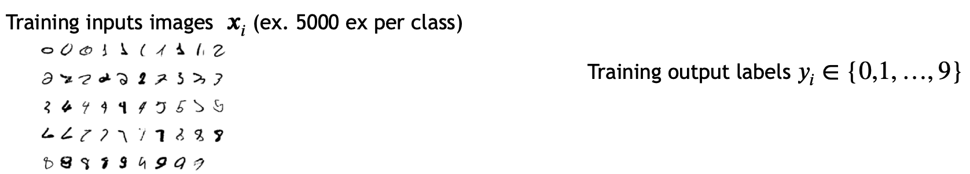
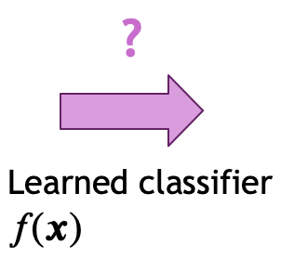
ML Intuition
Task: Digit Recognition
Learn the function (?) from the data

Slide 11
ML Intuition
Task: Digit Recognition
Challenges:
How do we acquire data? Someone has to manually label examples.
How do we parametrize a set of functions to search?
How do we fit the function to data?
If a function works on training example, will it generalize on new data?

Slide 12
ML Intuition
Face Detection

Slide 13
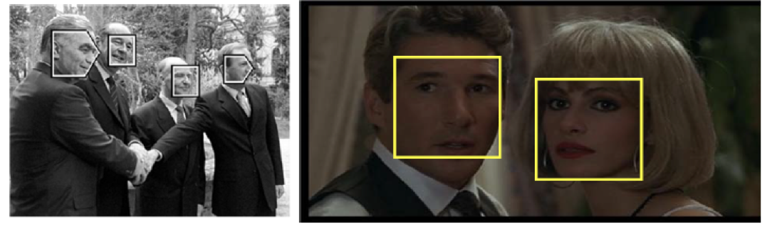
ML Intuition
Task: Face Detection
Build a face detector: for every region in image, determine if face is present or not
Harder problem: Harder to describe a face than a digit

Slide 14
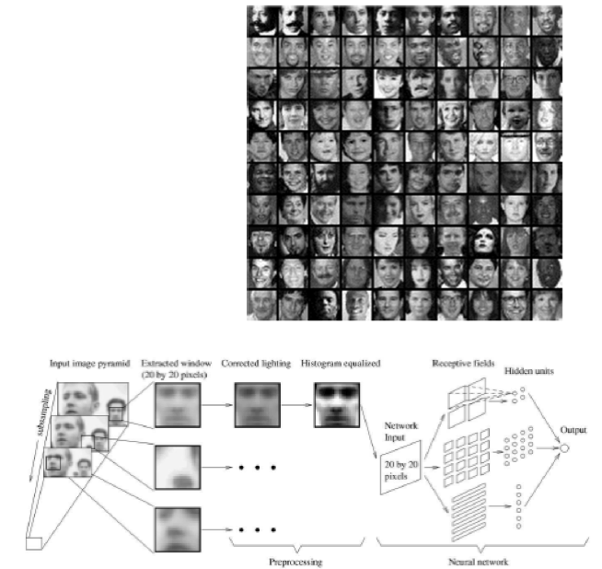
ML Intuition
Task: Face Detection
Build a face detector: for every region in image, determine if face is present or not
Harder problem: Harder to describe a face than a digit

Slide 15
ML Intuition
Spam Detection

Slide 16
ML Intuition
Task: Spam Detection
Build a spam detector: for every email, determine if spam or not
Harder problem: Harder to describe a text
Representing Text
Common model: bag of words
Enumerate all words,
Represent email via word count num instances of word
Challenges
Very high-dimensional vector
System must continue to adapt (keep up with spammers)

Slide 17
ML Applications

Slide 18
ML Problems Identification
Task 3

Slide 19
ML Problems Identification
Task3: List a set of problems that could be solved by ML in the following domains. Also specify their level of difficulty in solving.
Healthcare
Education
Banking
E-Commerce
Gaming
Any other problems around you

Slide 20
Types of Machine Learning

Slide 21
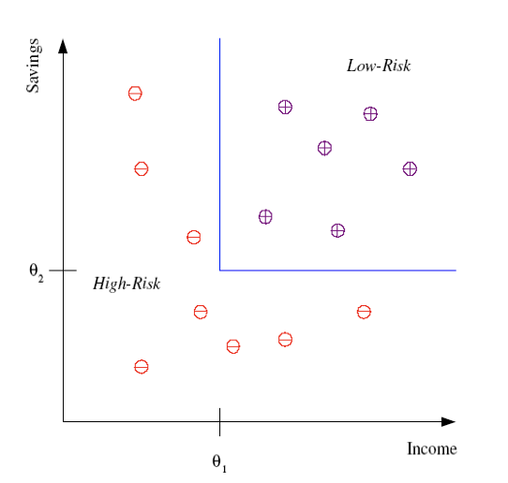
Classification
Supervised learning
Learn mapping from features x to target y
Classification:
Target is discrete. One of a finite number of values
Example: Credit assessment
Target: customer is high-risk or low-risk
Features: income & saving
Learn a function from features to target
Use past training data
Need to get this data
The function on the right is an example of a decision tree.

Slide 22
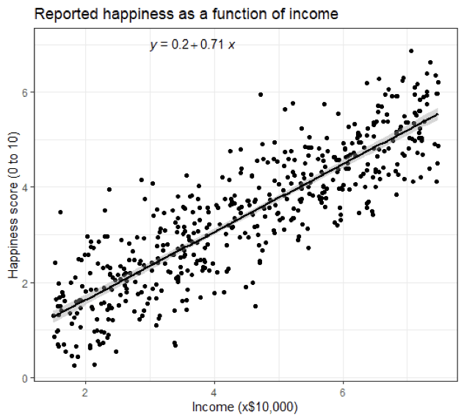
Regression
Also supervised learning
Predicting a continuous-valued target
Example:
Predict y=happiness score (e.g. from surveys)
From x=income, country, age, …
Can use multiple predictors
Assume some form of the mapping
Find parameters from data

Slide 23
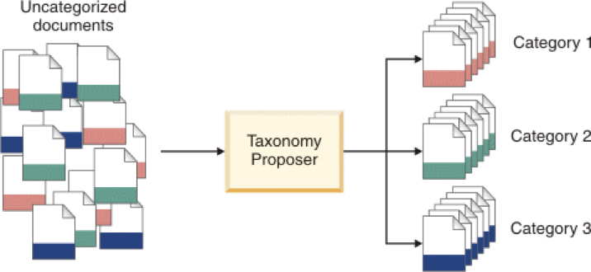
Unsupervised Learning
Learning "what normally happens"
No output
Just values x. No target y
Clustering: Grouping similar instances
Example applications
Customer Segmentation
Image Compression: Color Quantization

Slide 24
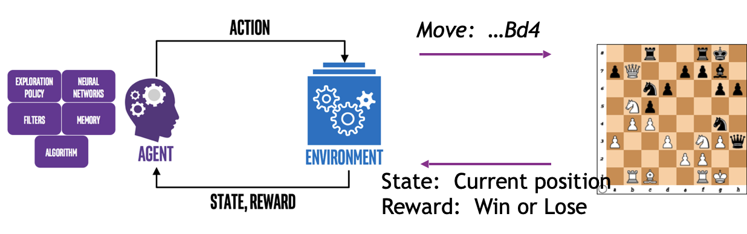
Reinforcement Learning
Agent learns to make actions that interact with an environment to maximize a reward
Exploitation (Learn from past actions) Vs Exploration (Try new choices)
Credit assignment: Which actions in the past led to the current reward?

Slide 25
ML Problem Types
Task 4

Slide 26
ML Problem Types
Task4: For the set of problems identified in Task3, specify their ML problem type (classification, regression, clustering, association, reinforcement) for the following domains.
Healthcare
Education
Banking
E-Commerce
Gaming
Any other problems around you

Slide 27
ML Concepts

Slide 28
ML Concepts
Label
Features
Example
Labeled Example
Unlabeled Example
Algorithm
Model
Classification
Regression
Unsupervised
Reinforcement
Linear Regression
Training
Loss
Gradient Descent
Learning Rate
Hyperparameter
Generalization
Training set
Test set
Validation set
Regularization
L₁
L₂
Accuracy
Precision
Recall
F1 Score
ROC
AUC

Slide 29
Labels
A label is the thing we're predicting—the y variable in simple linear regression.
future price of wheat
kind of animal shown in a picture
meaning of an audio clip

Slide 30

Features
A Feature is an input variable —the x variable in simple linear regression.
A simple machine learning project might use only a single feature or a set of features
Spam detection project features include:
words in the email text
sender's address
time of day the email was sent
email contains the phrase "one weird trick."

Slide 31
Examples
An Example is a particular instance of data x
Two types of Examples
Labeled examples - {features, label}: (x, y)
Unlabeled examples - {features, ?}: (x, ?)

Slide 32
Model
A model defines the relationship between features and label.
Two phases of a model's lifecycle:
Training means creating or learning the model. Show the model labeled examples and enable the model to gradually learn the relationships between features and label
Inference means applying the trained model to unlabeled examples. Use the trained model to make useful predictions (y').
Ex: Predict price for new unlabeled and unseen examples

Slide 33
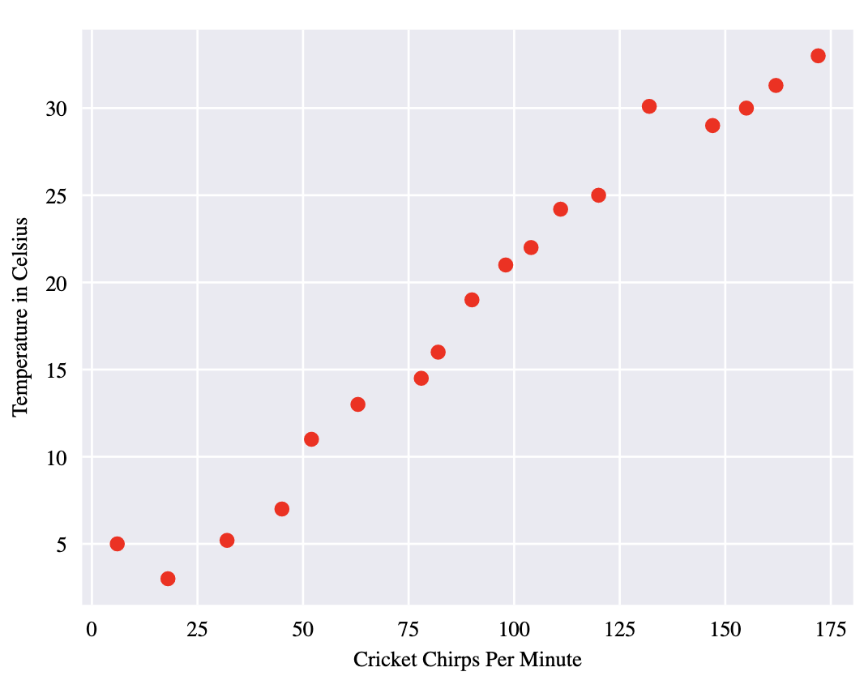
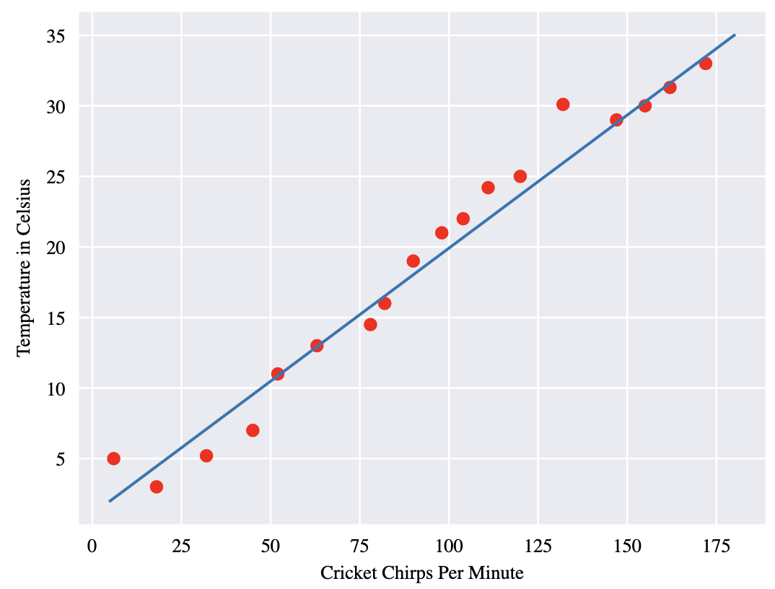
Linear Regression

Slide 34



Linear Regression – High school Math

Slide 35
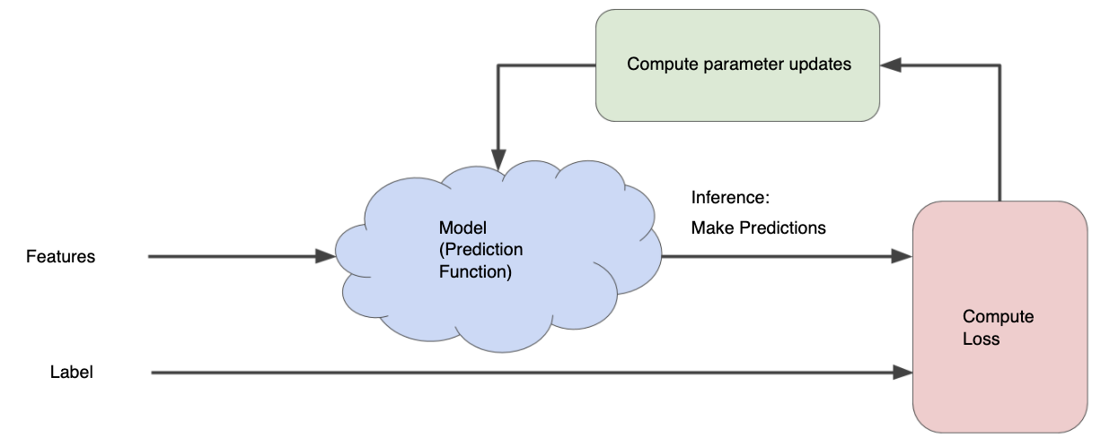
Model Training
Training a model simply means learning (determining) good values for all the weights and the bias from labeled examples.
In supervised learning, a machine learning algorithm builds a model by examining many examples and attempting to find a model that minimizes loss; this process is called empirical risk minimization

Slide 36
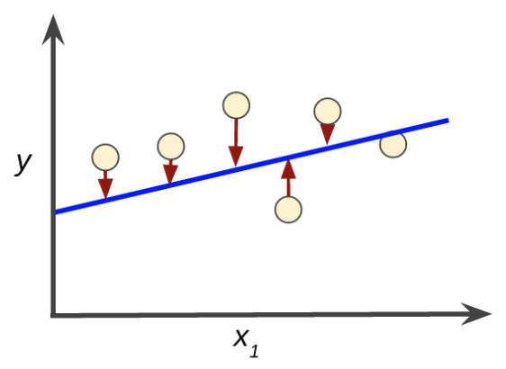
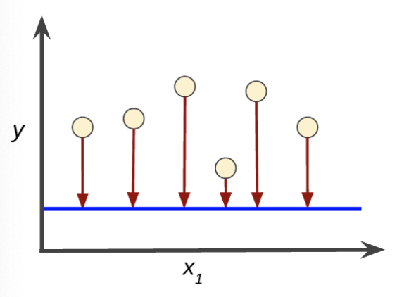
Loss
Loss - Penalty for a bad prediction
Goal: Find a set of weights and biases that have the least loss
A Machine Learning model is trained by starting with an initial guess for the weights and bias and iteratively adjusting those guesses until learning the weights and bias with the lowest possible loss.

Slide 37
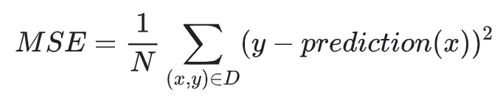
Loss
Mean Square Error (MSE) - Average squared loss per example over the whole dataset
Learning continues iterating until the algorithm discovers the model parameters with the lowest possible loss. Usually, iterate until overall loss stops changing or at least changes extremely slowly. When that happens, the model has converged

Slide 38
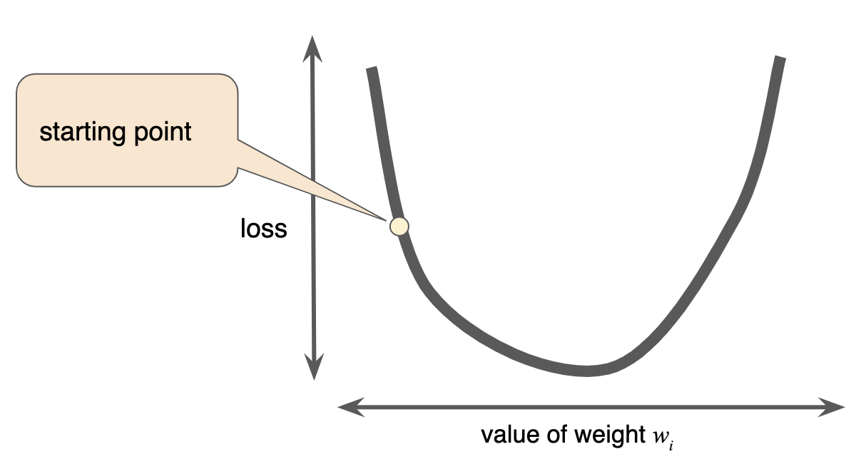
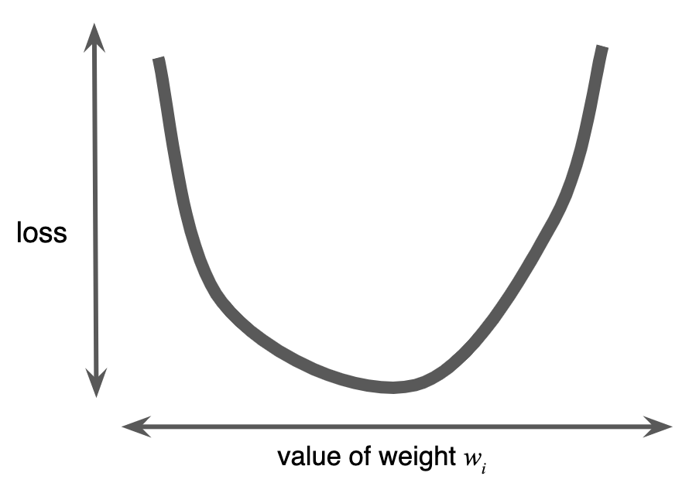
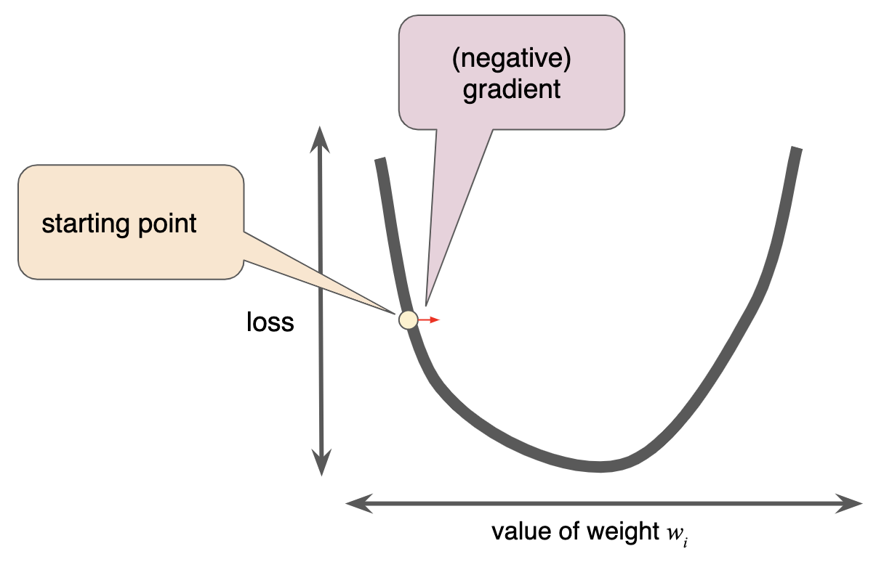
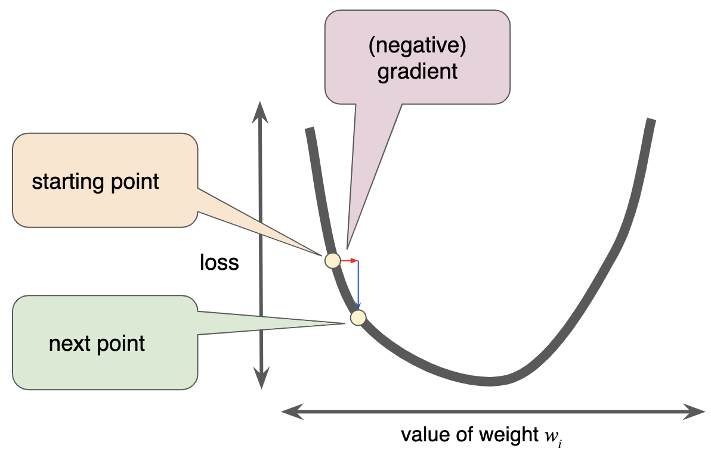
Gradient Descent
Gradients, Partial Derivates, Calculus

Slide 39
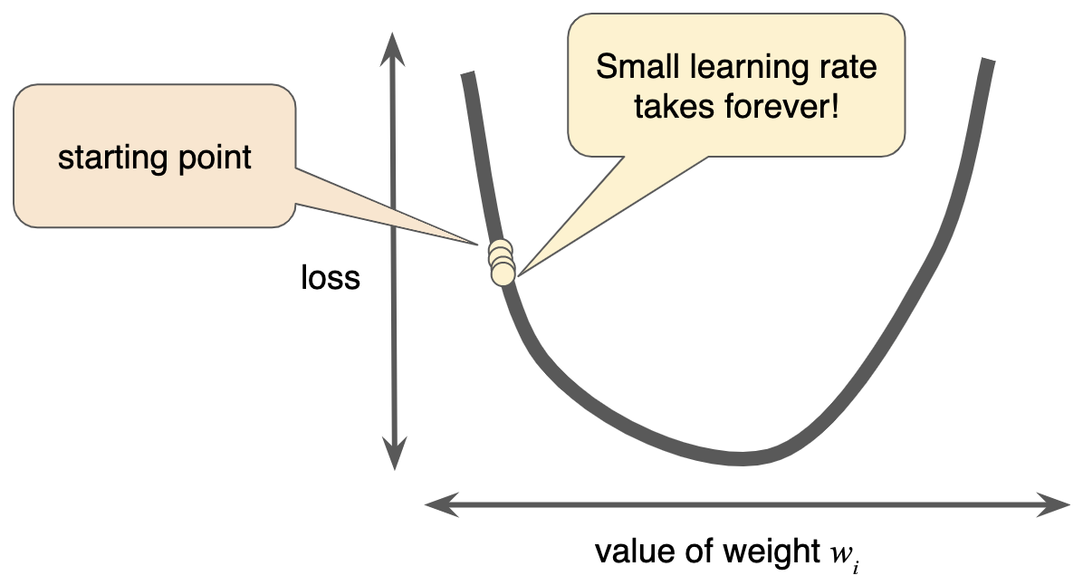
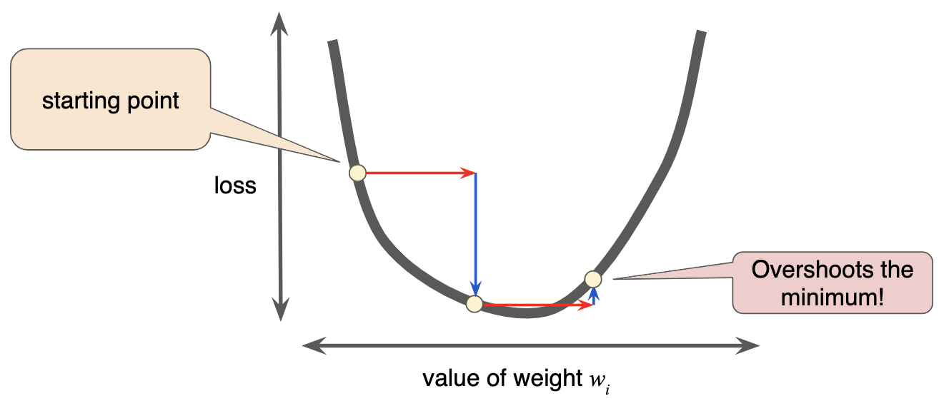
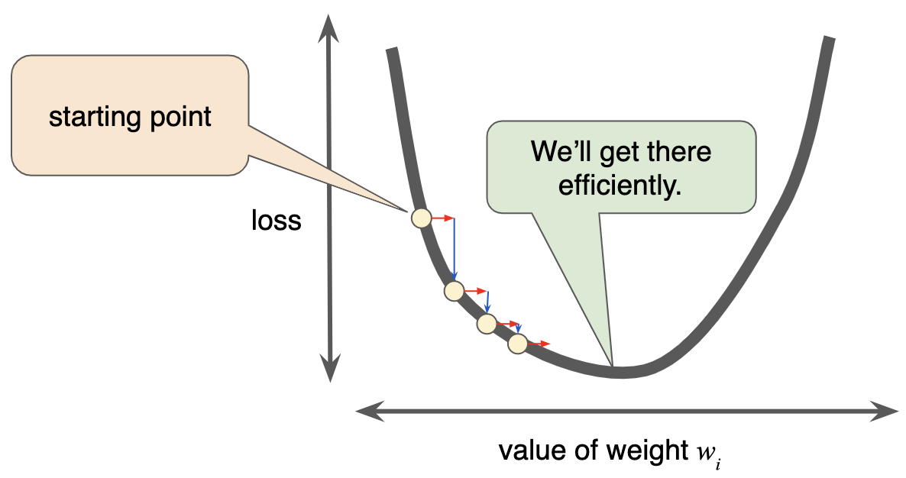
Learning Rate
Gradient descent algorithms multiply the gradient by a scalar known as the learning rate (also sometimes called step size) to determine the next point.

Slide 40
Hyperparameters
Hyperparameters are the knobs that programmers tweak in machine learning algorithms.
Goldilocks principle is used to find learning rate.
The goal is to find a learning rate large enough that gradient descent converges efficiently, but not so large that it never converges.

Slide 41
Types of Gradient Descent
Batch – Examples used to calculate gradient in a single iteration
Batch Gradient Descent - entire dataset (size=N examples) per iteration
Long time to compute gradients of the entire batch
Stochastic Gradient Descent (SGD) - 1 example (size=1) per iteration
Works fine but it is very noisy
Mini-Batch Gradient Descent (mini-batch SGD)
10-1000 examples (batch size = 10 or 1000 examples) per iteration
Reduces noise that occurs in SGD but efficient than Batch SGD

Slide 42
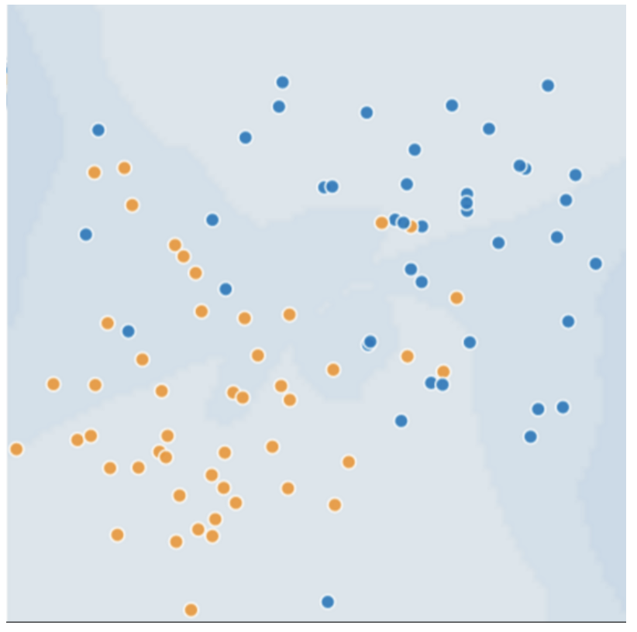
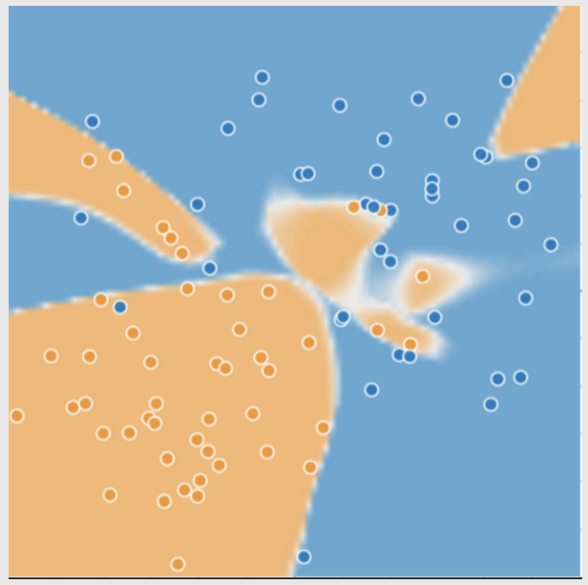
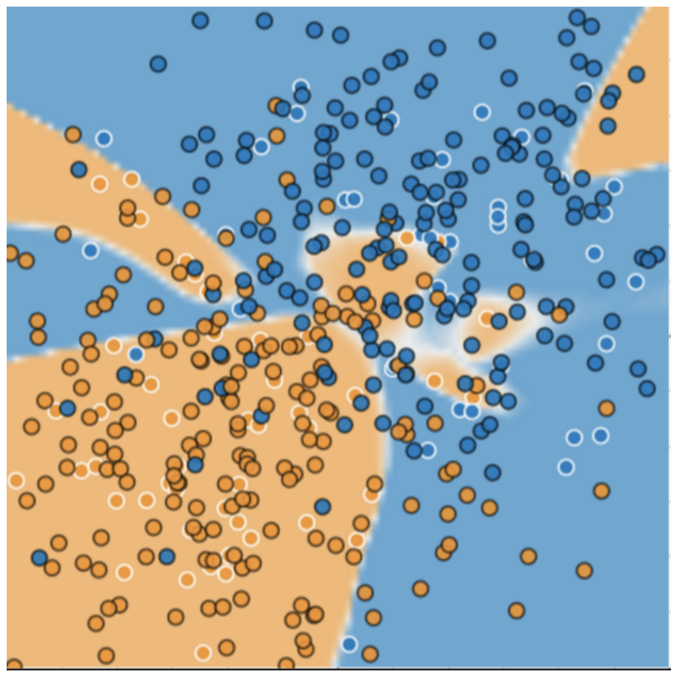
Generalization
Ockham's Razor
The less complex a ML model, more likely that a good empirical result is not only due to pecularities of sample
Overfitting occurs when a model tries to fit training data so closely that it does not generalize well to new data

Slide 43
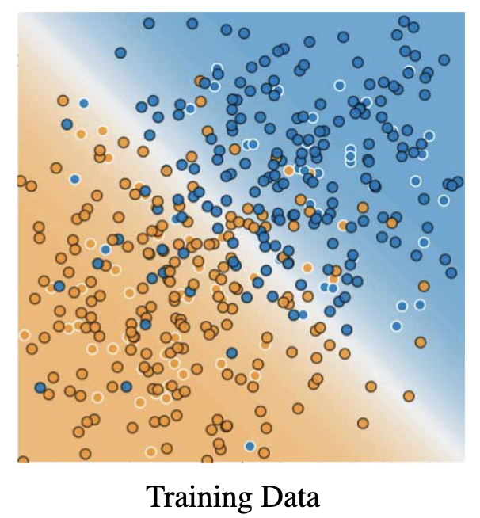

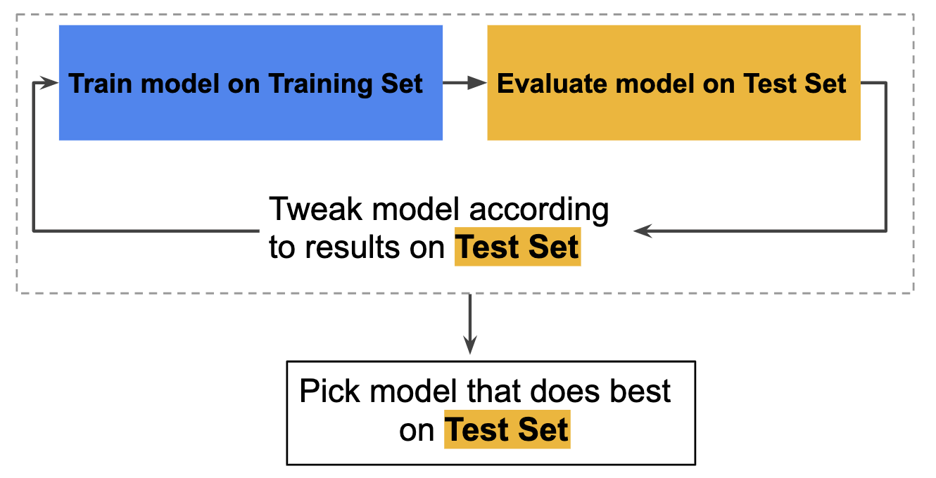
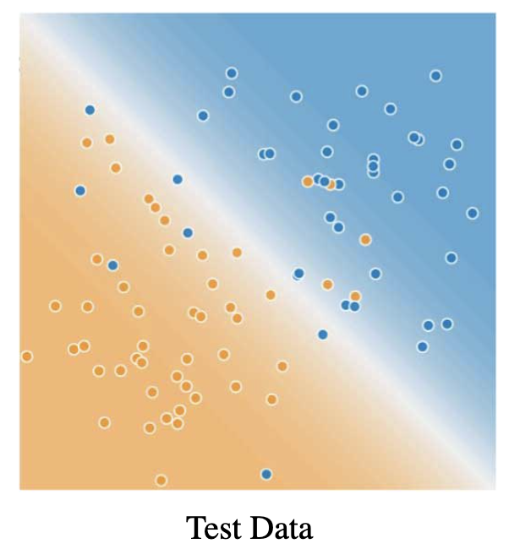
Dataset Splitting
Training set - a subset to train a model
Testing set - a subset to test the trained model

Slide 44
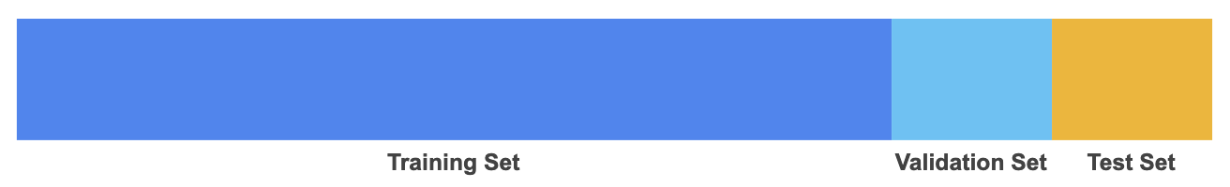
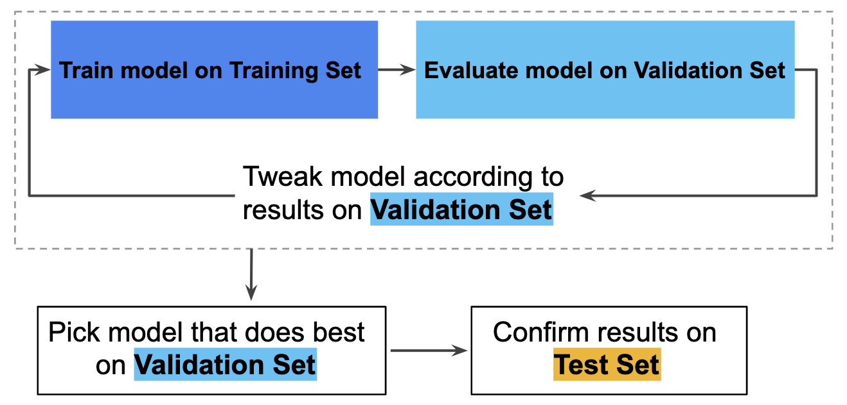
Training workflow
Training workflow
Pick the model that does best on the validation set.
Double-check that model against the test set.

Slide 45
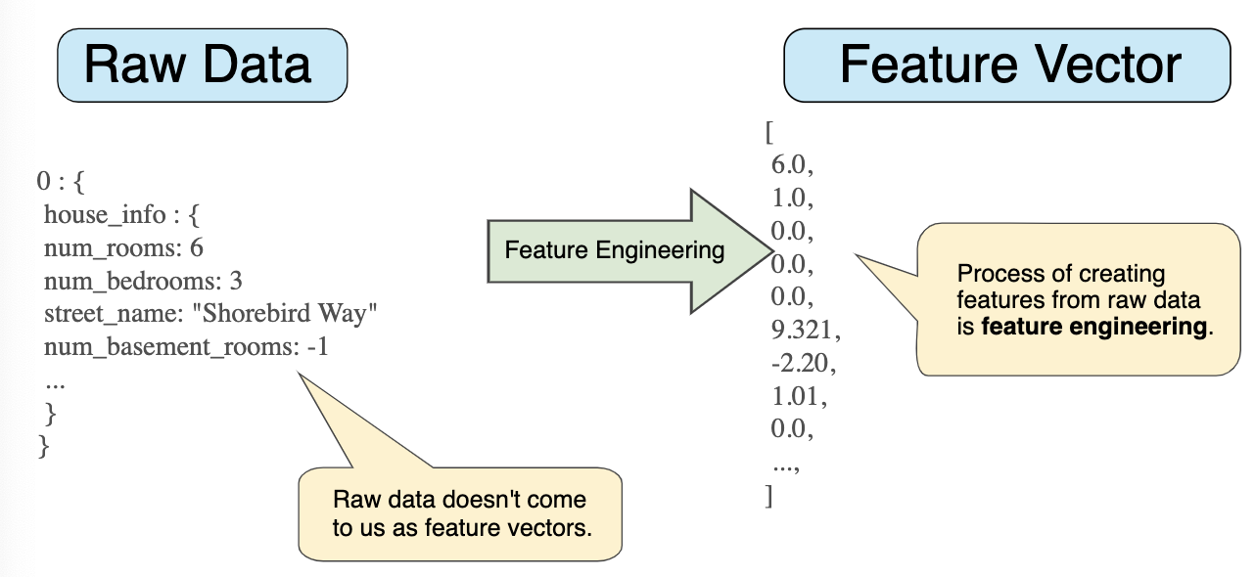
Feature Engineering
Feature engineering means transforming raw data into a feature vector
Mapping raw data into feature vectors

Slide 46
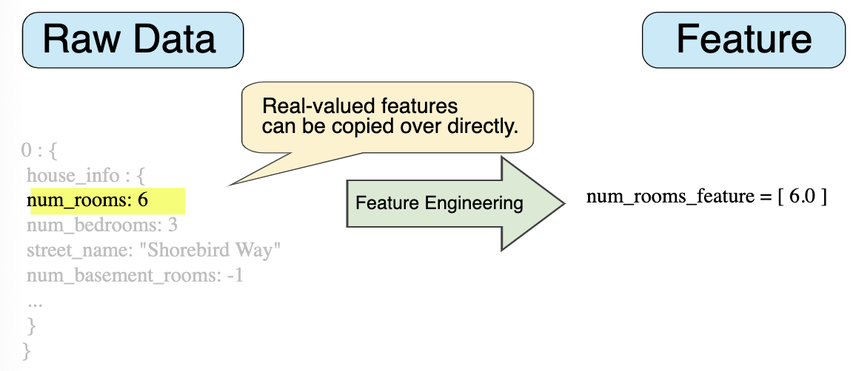
Mapping Numeric Values
Mapping integer and floating-point data don't need a special encoding

Slide 47
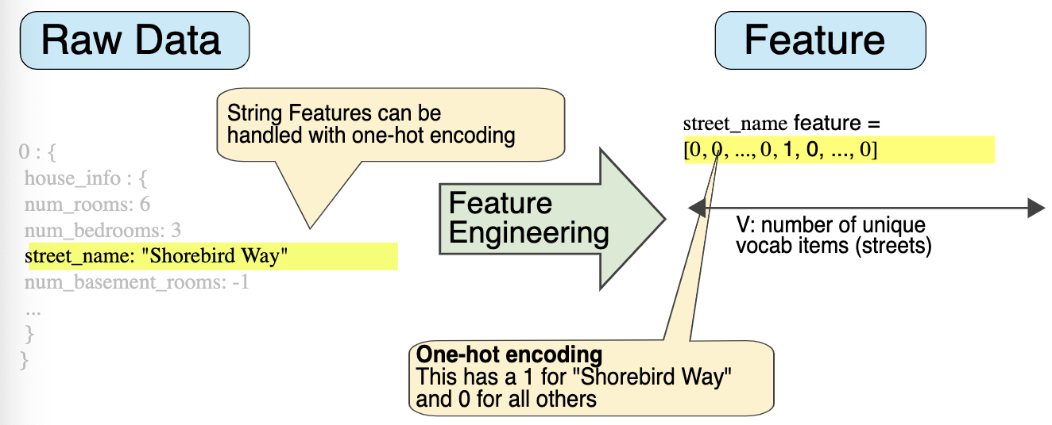
Mapping Categorical Values
Mapping categorical data need a one-hot encoding

Slide 48

Regularization
Penalize complex models to control and avoid overfitting
Empirical Risk Minimization
Structural Risk Minimization
Model complexity
Function of the weights of all the features in the model
Function of total number of features with nonzero weights

Slide 49
Regularization
Penalize complex models to control and avoid overfitting

Slide 50
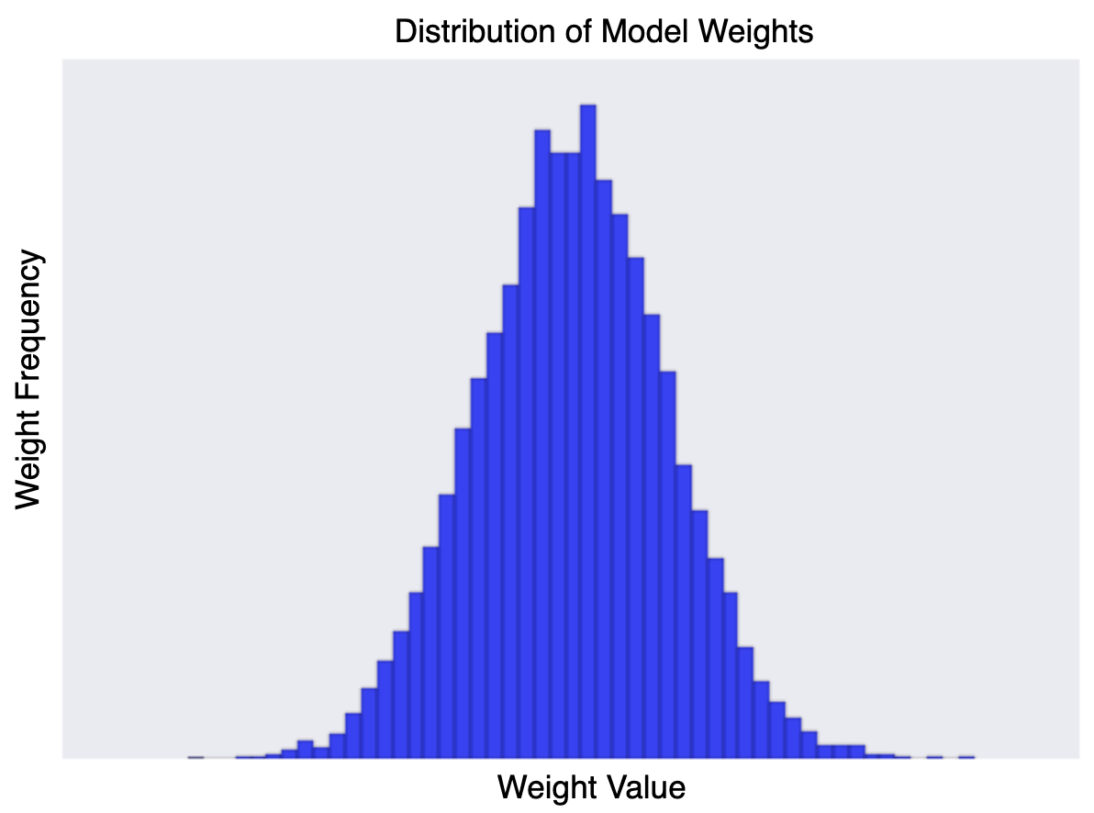
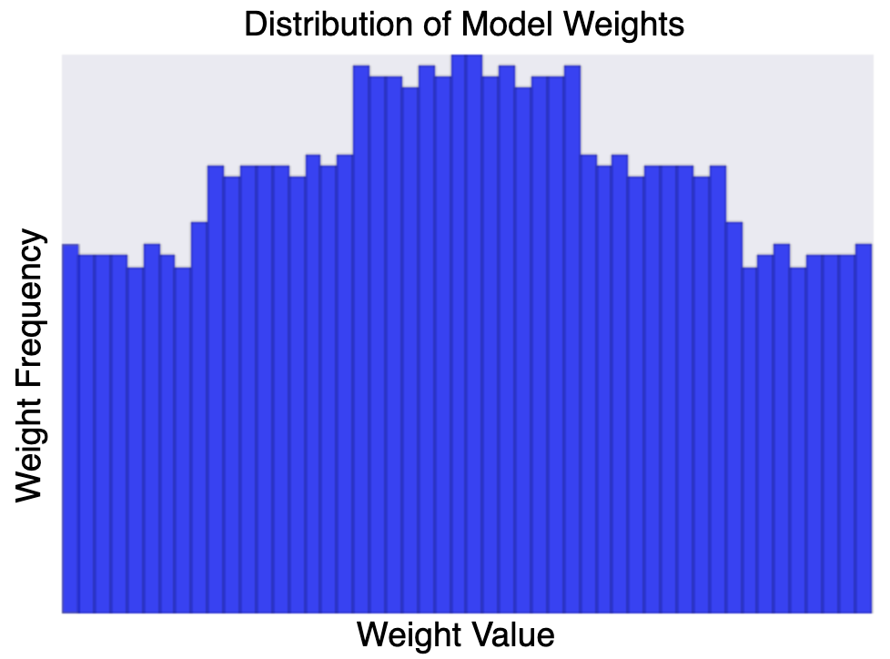
Regularization Lambda
Penalize complex models to control and avoid overfitting
If lambda value is too high, your model will be simple, but you run the risk of underfitting your data.
If your lambda value is too low, your model will be more complex, and you run the risk of overfitting your data.

Slide 51
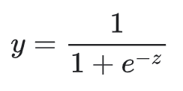

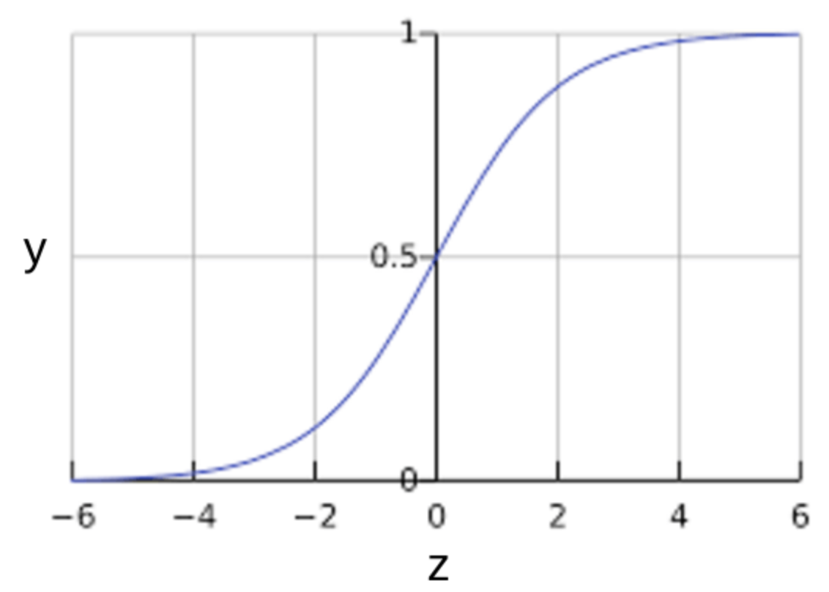
Logistic Regression
Calculating Probability using Sigmoid function
bias and weights: b = 1 w₁ = 2 w₂ = -1 w₃ = 5
feature values: x₁ = 0 x₂ = 10 x₃ = 2

Slide 52
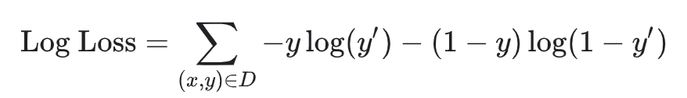
Loss function
Log loss function
Two strategies to dampen model complexity:
L₂ regularization
Early stopping (limiting the number of training steps or the learning rate)

Slide 53
Evaluation Metrics

Slide 54
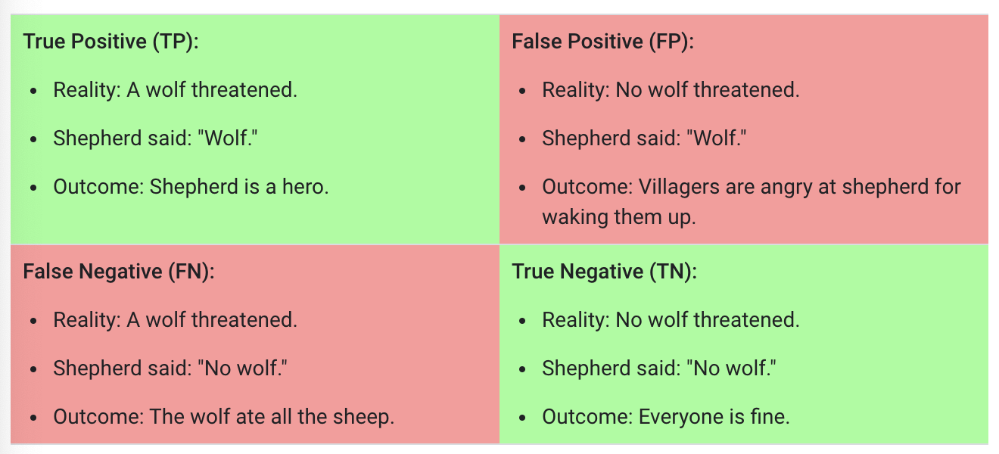
Classification Terminologies
An Aesop's Fable: The Boy Who Cried Wolf
A shepherd boy gets bored tending the town's flock. To have some fun, he cries out, "Wolf!" even though no wolf is in sight. The villagers run to protect the flock, but then get really mad when they realize the boy was playing a joke on them.
[Iterate previous paragraph N times.]
One night, the shepherd boy sees a real wolf approaching the flock and calls out, "Wolf!" The villagers refuse to be fooled again and stay in their houses. The hungry wolf turns the flock into lamb chops. The town goes hungry. Panic ensues.

Slide 55
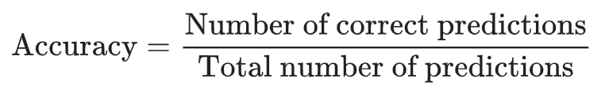
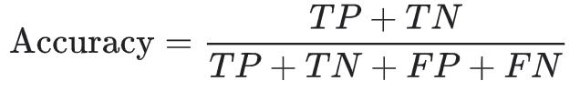
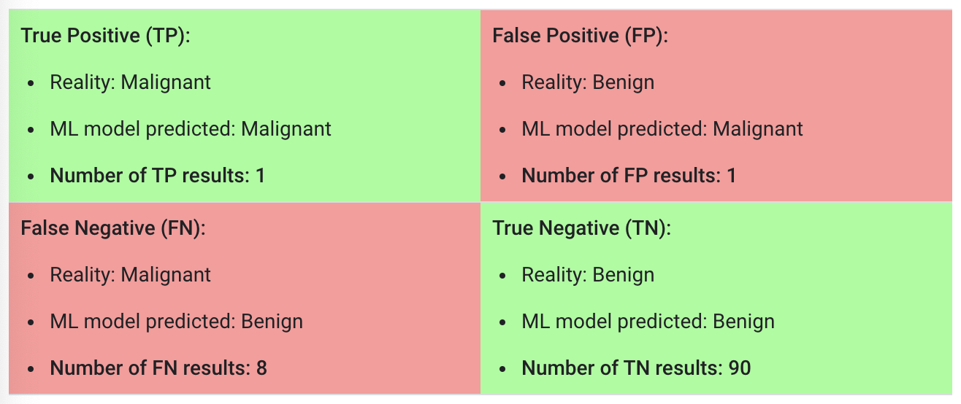
Classification Terminologies
Accuracy

Slide 56
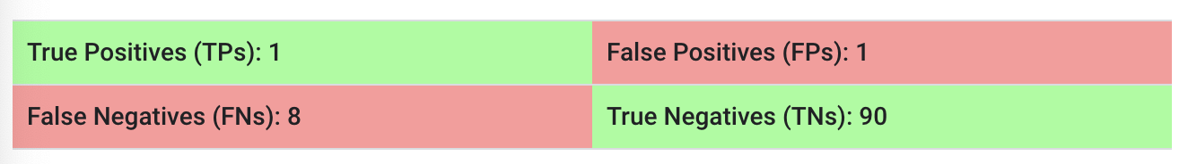
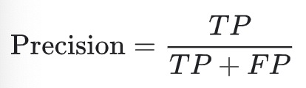
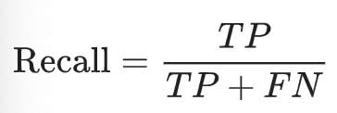
Classification Terminologies
Precision - What proportion of positive identifications was actually correct?
Recall - What proportion of actual positives was identified correctly?

Slide 57
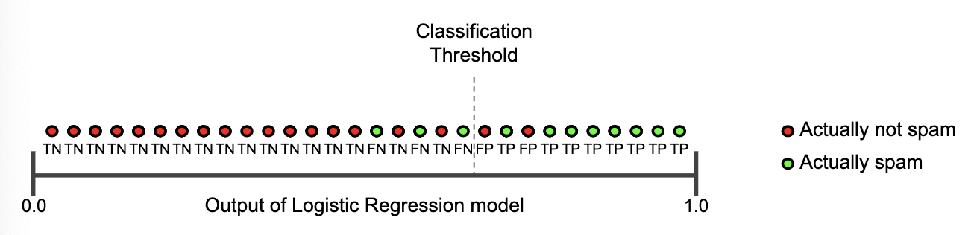
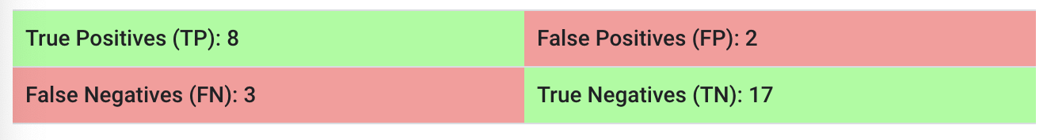
Precision and Recall: Tug of war
Precision - What proportion of positive identifications was actually correct?
Recall - What proportion of actual positives was identified correctly?

Slide 58
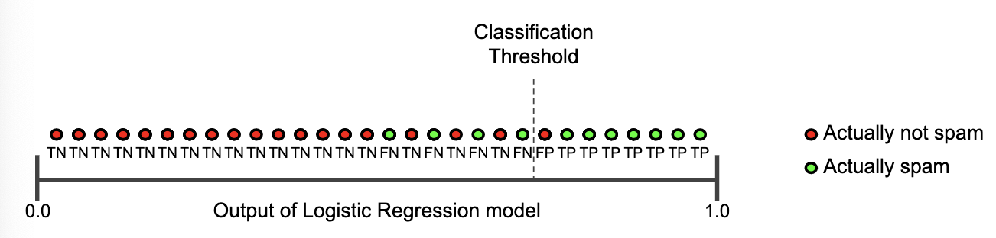
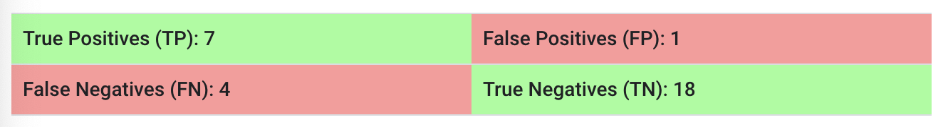
Precision and Recall: Tug of war
Precision - What proportion of positive identifications was actually correct?
Recall - What proportion of actual positives was identified correctly?

Slide 59


Precision and Recall: Tug of war
Precision - What proportion of positive identifications was actually correct?
Recall - What proportion of actual positives was identified correctly?

Slide 60



ROC Curve
ROC Curve plots TPR vs FPR at different classification thresholds
True Positive Rate (TPR) = Recall
False Positive Rate (FPR)

Slide 61

AUC: Area Under the ROC Curve
AUC measures the area underneath the entire ROC curve
AUC represents the probability that a random positive (green) example is positioned to the right of a random negative (red) example.
AUC ranges in value from 0 to 1. A model whose predictions are 100% wrong has an AUC of 0.0; one whose predictions are 100% correct has an AUC of 1.0.
AUC is desirable for the following two reasons:
AUC is scale-invariant. It measures how well predictions are ranked, rather than their absolute values.
AUC is classification-threshold-invariant. It measures the quality of the model's predictions irrespective of what classification threshold is chosen.

Slide 62
References
Images and concepts in the slides are used from the following resources
- Introduction to Machine Learning with Python Andreas Mueller
- Pattern Recognition and Machine Learning Christopher Bishop
- Machine Learning Course Google

